Slide 1

MONTE CARLO SIMULATION
SCL PACKAGE
DONE BY:
DIRAVINA EI – 22PD12
SMRITHI L – 22PD33

Slide 2
WHAT IS MONTE CARLO SIMULATION?
A Monte Carlo simulation is used to model the probability of different outcomes in a process that cannot easily be predicted due to the intervention of random variables. It is a technique used to understand the impact of risk and uncertainty from which we can make informed decision.

Slide 3
ABSTRACT
The Scientific Computing Lab Package presented here offers simulations and analyses for three application problems:
Budget for Sales Commissions
Birthday Problem
Monty Hall Problem.

Slide 4
PYTHON LIBRARIES USED
random
Used for generating random numbers for simulations.
math
Used for mathematical operations.
matplotlib.pyplot
Used for creating plots and data visualization.
pandas
Used for data manipulation and analysis,particularly working with DataFrames.
numpy
Used for numerical computing, especially arrays and mathematical operations.
scipy.stats.t
From the scipy library, used for calculating t-statistics and related functions.
seaborn:
Third-party library based on matplotlib, used for statistical data visualization.

Slide 5
Budget for Sales Commissions
This simulation-based approach calculates total commission amounts in a sales scenario by generating random sales data based on target values and probabilities. It computes commissions based on percentage-to-target achieved by sales reps, providing insights into commission effectiveness.

Slide 6
Mathematical Explanation of Budget for Sales Commissions
Generating Random Variables
A list of possible sales target values and the probabilities associated with each sales target and average and standard deviation used for generating the percentage to target
Calculating Commission
Total Sales = ∑(Percent to Target×Sales Target​)
Total Commission Amount = ∑(Commission Rate; ×Sales)

Slide 7
Mathematical Explanation of Budget for Sales Commissions
Simulation
The simulation calculates sales based on a percentage-to-target achieved by sales representatives. This percentage is generated randomly from a normal distribution with a mean of 1 and a standard deviation of 0.1.
Using this simulated sales data, commission rates are applied

Slide 8
Mathematical Methods Used in Budget for Sales Commissions:
Statistical Calculations:
Mean, minimum, maximum, median of sales and commission amounts.
Total sales, total commission amount, and total sales target calculations.
Calculation of confidence intervals for sales and commission amounts.
Sensitivity Analysis:
Changing a variable (like Sales_Target or Commission_Rate) and calculating resulting Total Commission Amounts.

Slide 9
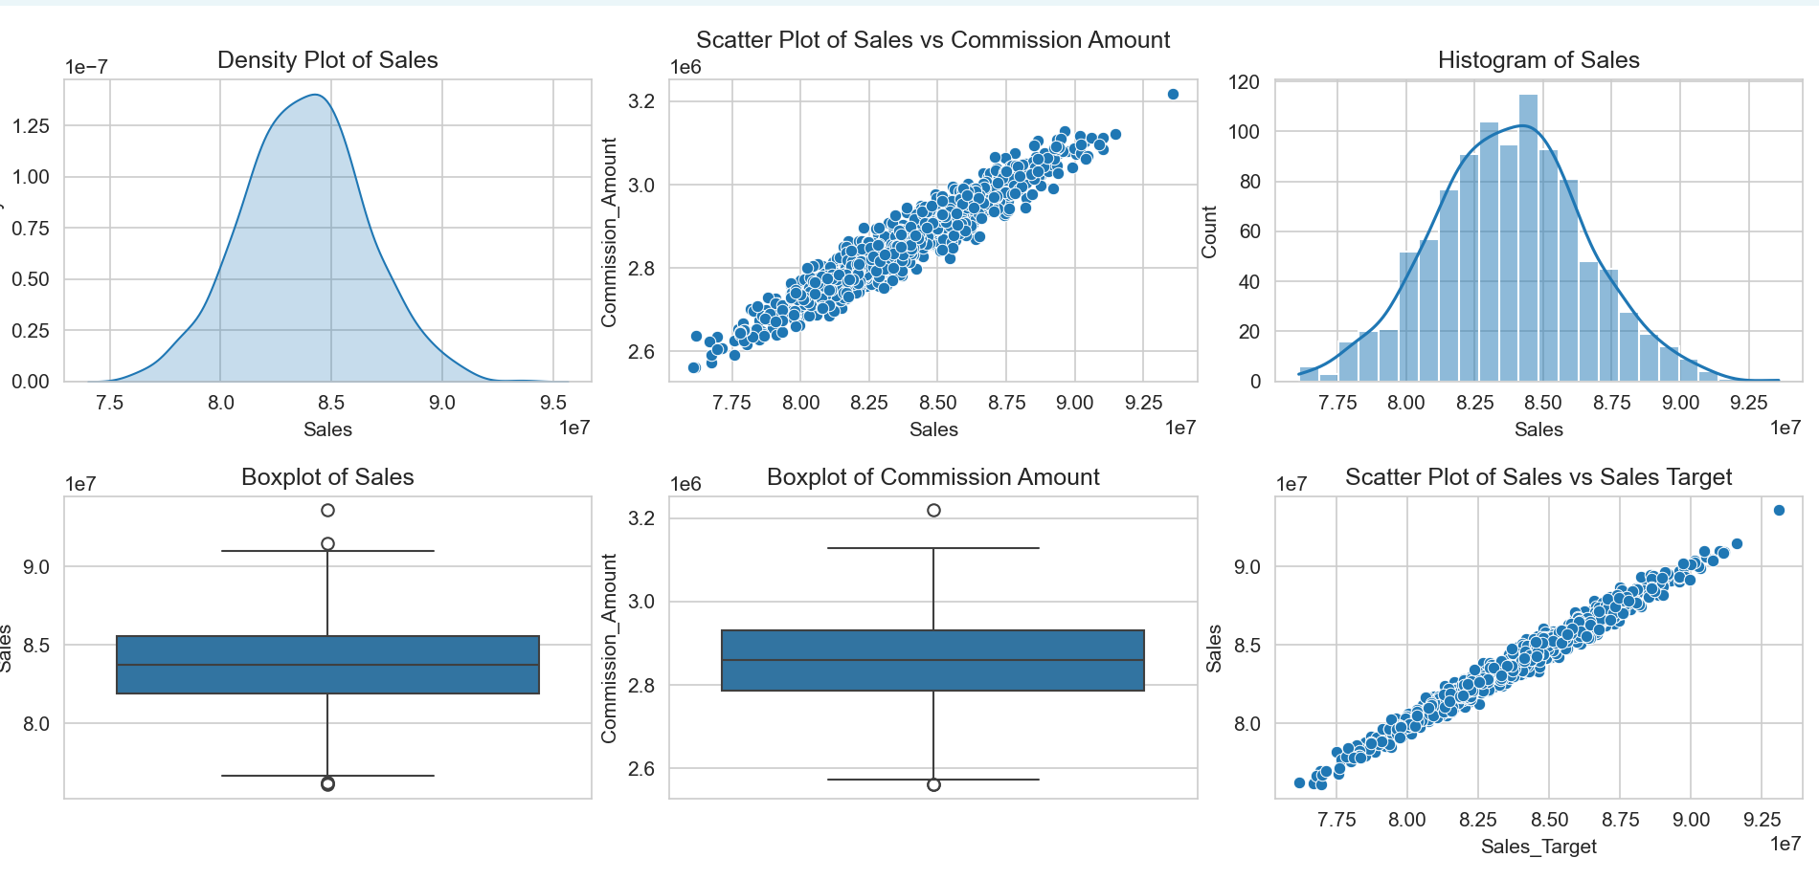
Visualization

Slide 10
Conclusion
It provides insights in understanding how different sales targets and commission rates impact the total commission amount.
It provides effectiveness of the commission structure in relation to sales performance.
Through sensitivity analysis, it allows users to understand how changes in variables like sales targets or commission rates affect total commission amounts.
This package is useful for businesses to optimize their commission structures based on expected sales performance.

Slide 11
Birthday Problem
The code simulates the classic Birthday Problem, where it calculates the probability of at least two people sharing a birthday in a group of a given size. It runs simulations and plots the probabilities over multiple trials.

Slide 12
Mathematical Explanation of Birthday Problem
The Birthday Problem is a classic probability problem that asks: "What is the probability that, in a group of n people, at least two of them have the same birthday?“
Birthdays are equally likely to occur on any day of the year, disregarding leap years.
The problem asks for the probability of at least two people sharing a birthday, not a specific pair.

Slide 13
Birthday Problem Approach
Probability of No Shared Birthday
Probability of At Least One Shared Birthday
The final probability formula for at least two people sharing a birthday in a group of n people is:
P(At least 2 people share a birthday) = 1- (365/365)*(364/365)*(363/365)*....*(365-(n-1))/365
Simulation: The problem can also be simulated by generating random birthdays for n people multiple times and counting the occurrences where at least two people share a birthday.

Slide 14
Mathematical Methods used in Birthday Problem
Simulations
Probability Calculation
Statistical Analysis

Slide 15
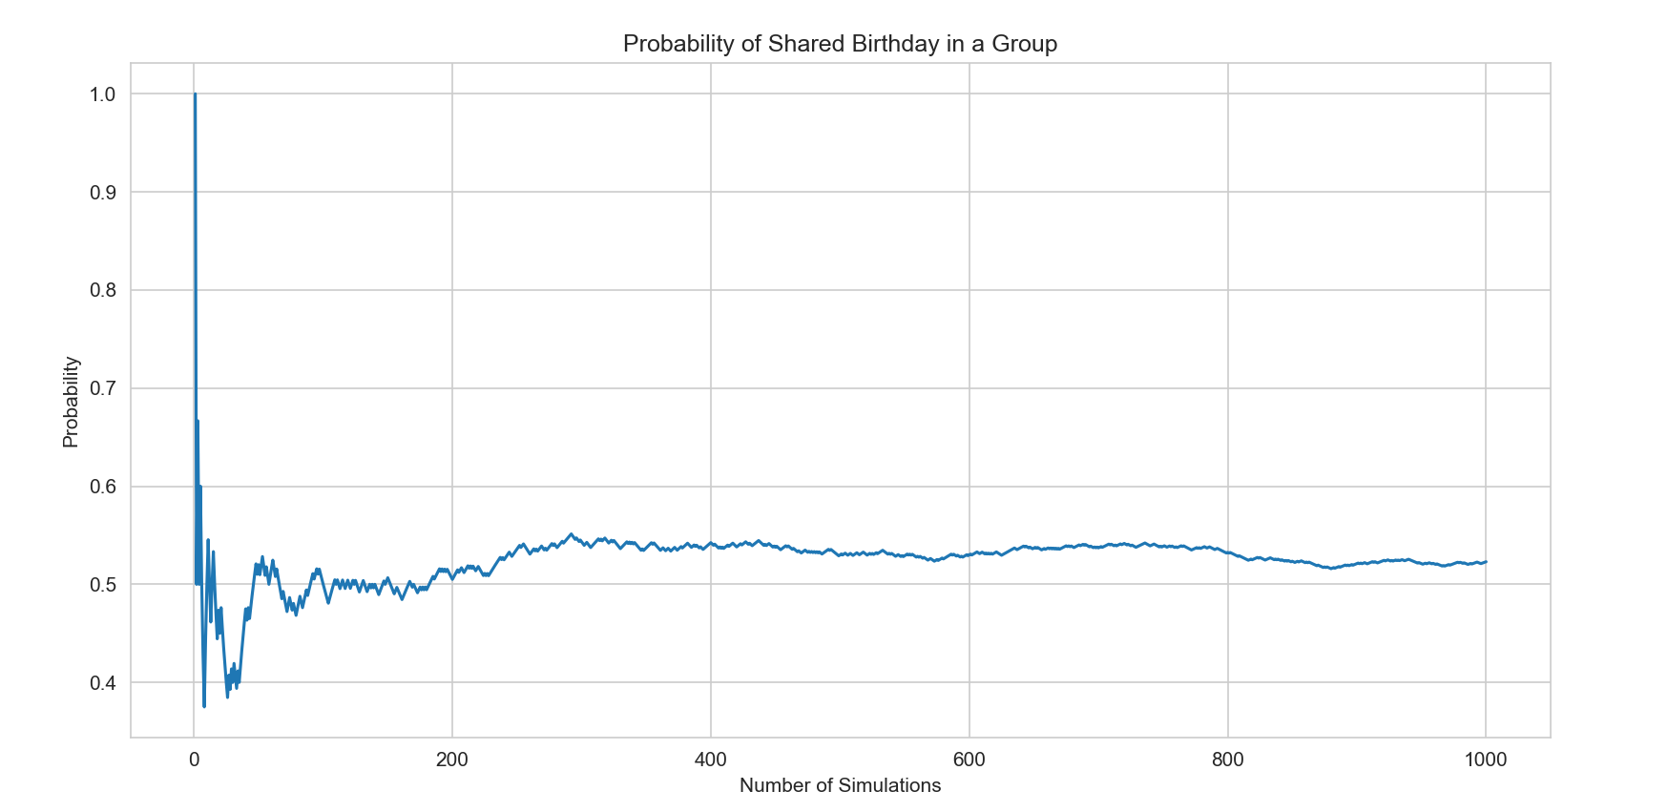
Visualization

Slide 16
Conclusion
It illustrates the concept of probability and the counterintuitive result where the probability is higher than expected.
Useful for understanding and visualizing probability concepts in a simple, relatable scenario.

Slide 17
Monty Hall Problem
The Monty Hall Problem simulation analyzes the famous probability puzzle. It calculates the winning probabilities when a contestant chooses to switch or stick with their initial choice in a game show scenario with three doors.

Slide 18
Mathematical Explanation of Monty Hall Problem
Probability puzzle based on a game show scenario
The game show host presents the contestant with three doors. Behind one door is a valuable prize (the car), and behind the other two are less valuable prizes (goats).
The contestant picks one door, and then the host, who knows what's behind each door, opens another door that does not contain the car, revealing a goat.

Slide 19
Strategies and Analysis
Sticking: If the contestant sticks with their original choice, their chance of winning is simply the probability that they initially picked the car, which is 1/3
Switching: If the contestant switches doors after the host reveals a goat, the probability of winning increases.
Initially, the chance of picking the car is 1/3 and the chance of picking a goat is 2/3
When the host reveals a goat, the 2/3 probability of initially picking a goat gets consolidated into the unopened door.
So, when given the option to switch, the probability of winning by switching becomes 2/3 while the probability of winning by sticking remains 1/3

Slide 20
Mathematical Method used in Monty Hall Problem
Simulations
Conditional Probability
Statistical Analysis

Slide 21
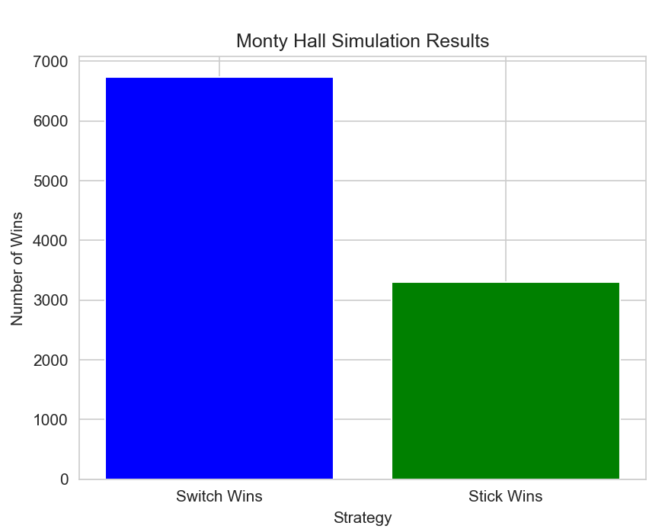
Visualization

Slide 22
Conclusion
Despite the intuition that both unopened doors should have equal probabilities after the host reveals a goat, the math shows that switching doors gives a 2/3 chance of winning, while sticking only gives 1/3
Demonstrates the counterintuitive probability scenario in the Monty Hall game show problem.
Through simulations, it shows the advantage of switching doors in the game.
Useful for illustrating conditional probability and strategic decision-making in a fun, engaging way.

